Slide 1
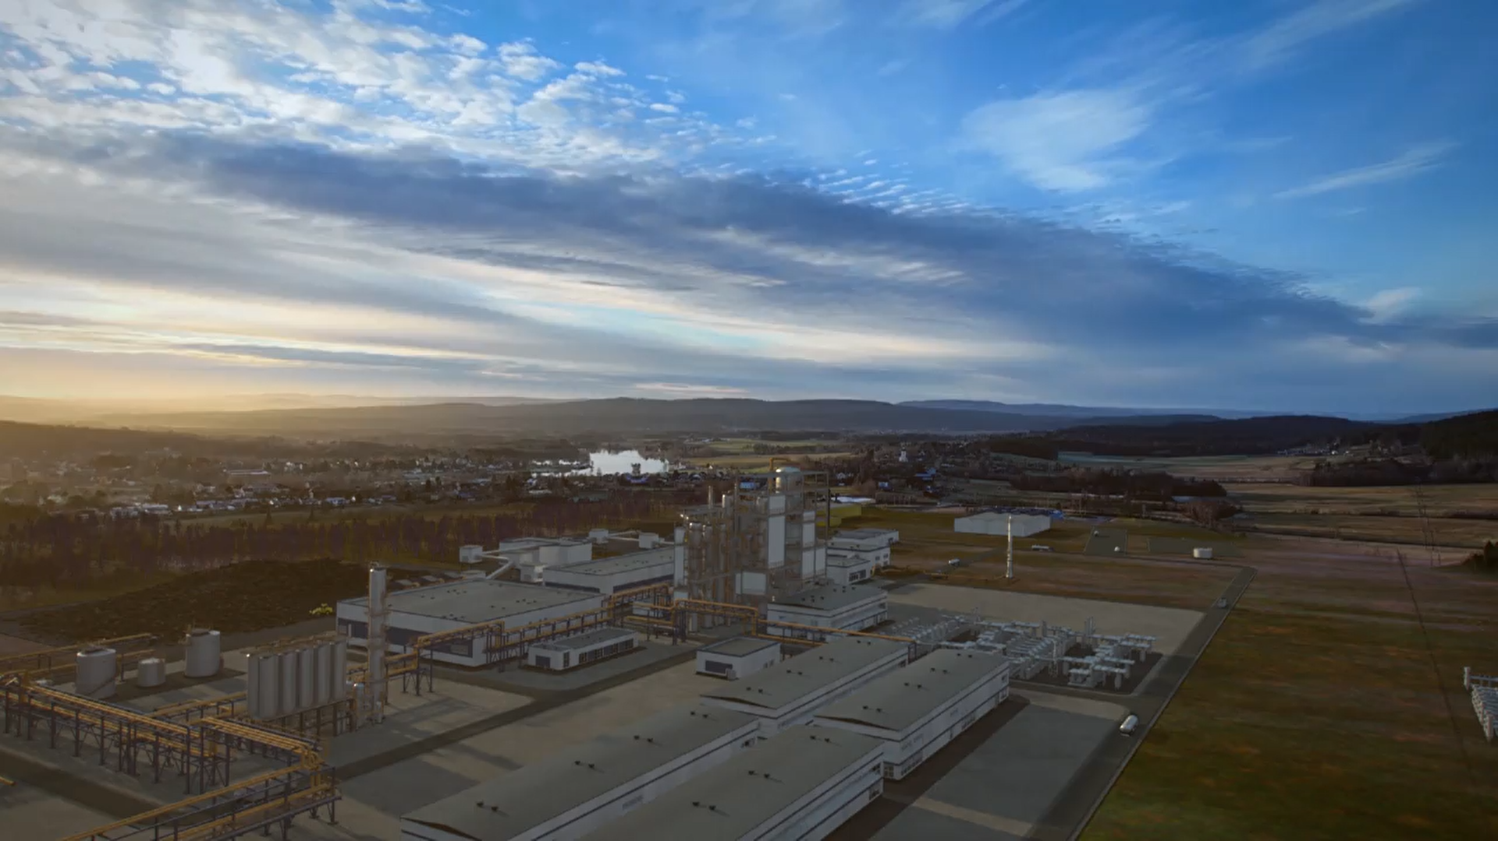


SAF production in Northern Sweden
June 2024

Slide 2


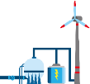





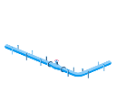




At a glance
Renewables
Coal-fired
power plant
Hydrogen
7,000 employees ensure security
of supply in Europe
Active in more than 40 countries
~ 22.4 GW generation capacity
Entire business to be carbon-neutral
by 2040
Gas portfolio consisting of roughly
200 TWh
€6.3 billion adjusted EBIT (FY 2023)
Trading
Sales
​
Gas-fired
power plant
Hydropower
​
​
Gas
infrastructure
Nuclear
Gas storage
LNG
Services

Slide 3

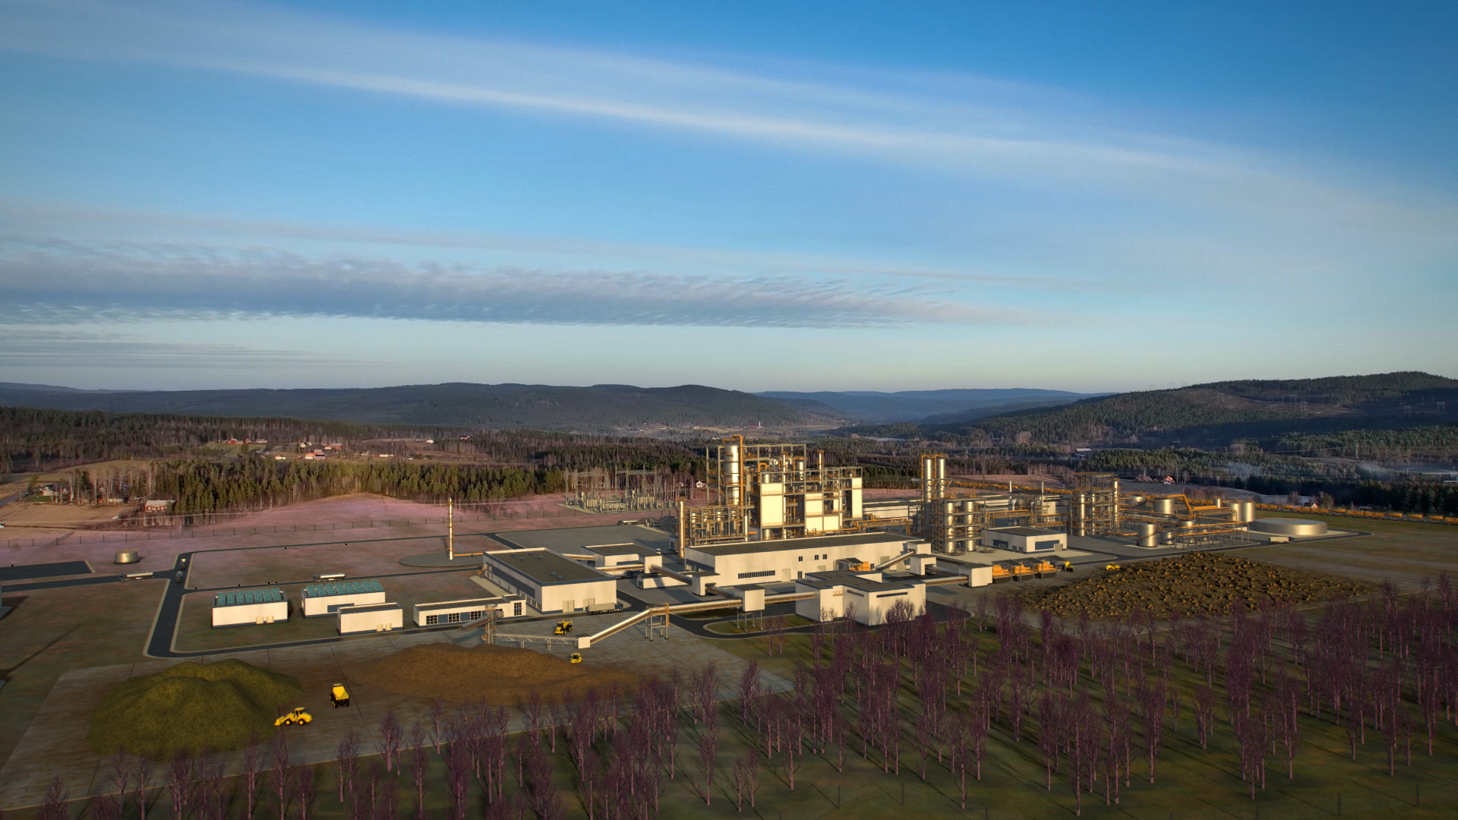

SkyfuelH2 to produce 77 kt/a of SAF and 16 kt/a of Naphtha
and offering a unique value proposition
Designed for replicability
Economies of
scale driven
Highest efficiencies in a de-risked way
Access to ideal site for Green Fuels
“An innovative project serving as a blueprint for greenfield replicability.”
“One of the largest non-HEFA type SAF production facilities currently being developed in Europe.”
“De-risked PBtL technology concept with highest levels of carbon, chemical and energy efficiency.”
“Most promising region for RFNBO and advanced bio SAF.”

Slide 4
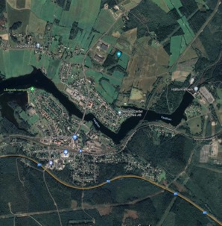



SkyfuelH2 is located in Northern Sweden, one of the most
competitive areas in Europe for renewable energy and fuel production
Sollefteå strategic site location: Unique advantages
Access to RFNBO/REDIII compliant renewable power: >8.000 h/y, >95% renewable share at most price competitive costs in EU
Highly competitive power price zone (SE2)
Sollefteå
Strong regional forestry industry
High availability of sustainable, REDIII and ReFuelEU compliant biomass feedstocks
Logistical access via road, railway and sea
Ease of biomass delivery and product distribution
Site and grid capacity have been secured. Permitting process is initiated.
Detailed development plan was approved in 2023.

Slide 5
Technical blueprint is targeting high energy and carbon
efficiencies and flexibility regarding sustainable feedstocks
BtL¹
Sustainable Biomass
Bio-SAF
Gasification
Carbon
Bio-Naphtha
Fischer-Tropsch
Synthesis + Refining
Oxygen
Syngas
Electrolysis
Hydrogen
e-SAF (RFNBO)
Renewable Power
PtL²
e-Naphtha (RFNBO)
+125% higher SAF yield from biomass vs BtL
+10% higher energy efficiency from integration
¹ Biomass-to-Liquid
² Power-to-Liquid

Slide 6









Creating a bankable commercial structure blueprint
across the value chain
Feedstock suppliers
Product offtakers
Contractually securing competitive feedstock provision long-term
SAF-offtake contracts’ duration currently
indicated for 10 years.
O&M agreement and operational staffing.
Environmental, construction, operation permit.
Public funding, Project finance with lenders.
Sales contracts & negotiations with offtakers.
Power, Biomass and water supply. Logistics concepts.
Land acquisition, lease, infrastructure concepts, power grid connection.
Foundation of JV, Administration agreement.
Intellectual Property Licensing.
Local authorities & site owner
Technology providers
Ideal site successfully acquired
Envisaged performance guarantees and high TRLs of technology components

Slide 7
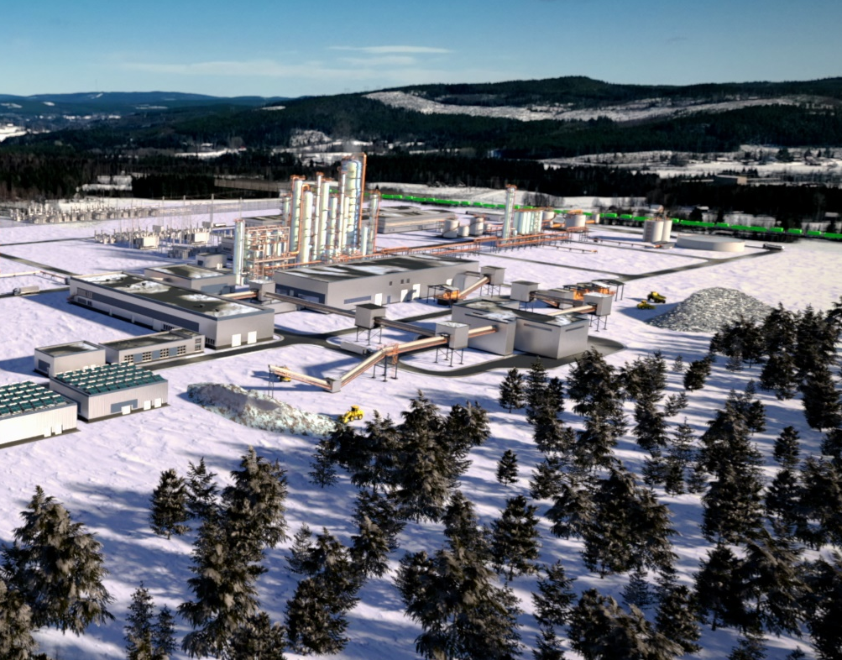











Project Timeline
Key milestones
2020: Project initialization
2023: Pre-FEED phase completed
2024
FEED phase
(Front End Engineering Design)
SkyfuelH2 has been significantly de-risked by successfully completing pre-FEED phase.
2026
EPC phase
(Engineering, Procurement and Construction)
Cold and hot commissioning
Start of FEED planned for 2024 with Commercial Operation Date expected in 2029.
SkyfuelH2 will be commercially structured and de-risked to enable project financing.
2029: Commercial operation

